Slide 1
Abusive word analysis in social media : case study of Indonesian tweet
ALFIAN BANI KUSUMA
(Binar Academy Student, DSC BATCH 10)

Slide 2
Background :
According to published survey in February 2021 about the digital courtesy of world internet users in 32 countries, Digital Civility Index (DCI) has found that Indonesia ranked the lowest or the most impolite nation in South East Asia region. The score itself has range score from 0-100, the lowest score means the lower online risk (Unpas, 2021)*
The highest factor that contribute to that score is the Hoax or fraud information in Indonesia cyberspace. Although Hate Speech are not considered the number one contributor, it alone contributed 27% of the score. It means the probability of people being bullied in cyberspace or social media are relatively high in Indonesia.
Therefore, the need of cleaning hate speech for safe for work (SFW) environment is imperative, especially in social media.
Notes:
https://www.unpas.ac.id/en/national-social-media-day-and-the-pitiful-side-of-indonesian-netizens/

Slide 3
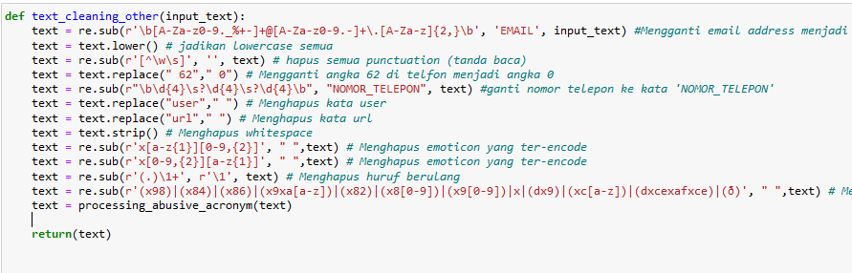
Research Method:
This research is using the dataset from (Muhammad Okky Ibrohim and Indra Budi. 2019)* which contain 13168 row of Indonesian tweets. It also have 11 columns of Hate Speech label, and For each label, `1` means `yes` (tweets including that label), `0` mean `no` (tweets are not included in that label). Due to the Twitter's Terms of Service, the dataset are not displaying the tweet ID, instead it was changed into ‘USER’, the same thing goes for any URL.
The function used mainly from regex or built-in function from the Python itself. The list of function used can be seen here:
Notes:
(*) for Reference = Muhammad Okky Ibrohim and Indra Budi. 2019. Multi-label Hate Speech and Abusive Language Detection in Indonesian Twitter. In *ALW3: 3rd Workshop on Abusive Language Online, 46-57

Slide 4
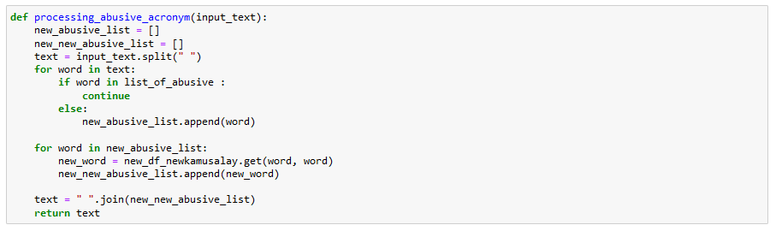
Research method(cont.)
Text normalization from slang words and typo also be included in this analysis, alongside with the removal of any abusive words in the tweets dataset.
The list of abusive word and text normalization list are referring to an external lists. Thus, the function to remove both abusive and text normalization can be seen here:

Slide 5
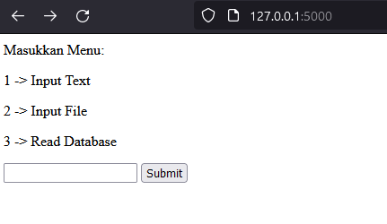
Research method (cont.)
Furthermore, we built restful API for those function to ease its applicability for user. The restful API itself contains three menu with different cleaning application: for word to word, file to word, and reading database. We use sqlite 3 for built-in database. Example usage of the restful API can be seen below:
For text analysis, we use Descriptive Analytics method to understand the effectiveness of the function used for cleaning and changing slang words from given datasets.
We also using comparation analysis to further understand the amount of the data before and after cleaning. Later the results are visualized to compare the data more easier to read.

Slide 6
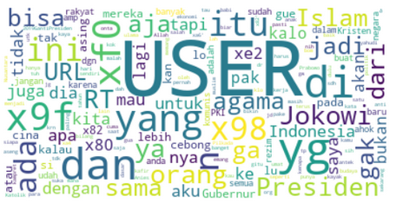
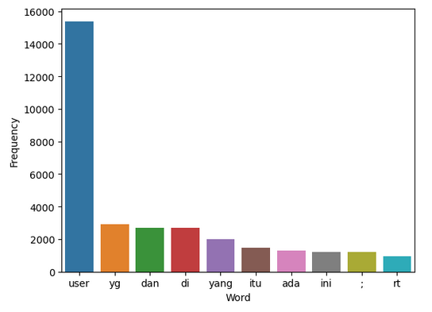
Results and Discussions:
By using word cloud analysis for the dataset before cleaning. It can be identified that the word “USER” are dominant (>14000). Later, it was confirmed with the bar plot that shows the frequency of the top 10 word being used are “USER”:
By this data, it can be said that the abusive and hate speech in the dataset are mostly intended to a certain individual (or group) by the word ‘USER’ used.

Slide 7
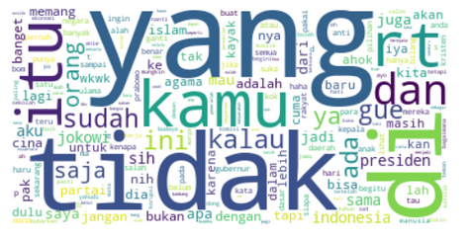
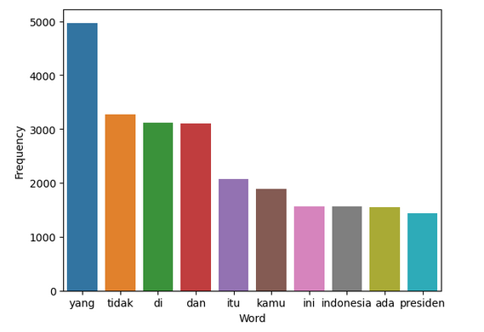
Results and Discussions(cont.)
After text cleaning process, the word cloud and bar plot has changed respectively. Notice that the acronym word “yg” has become “yang” after the cleaning process, and simultaneously boost the word “yang” to become the most frequently used. It means the cleaning process from the API was functioning well.

Slide 8
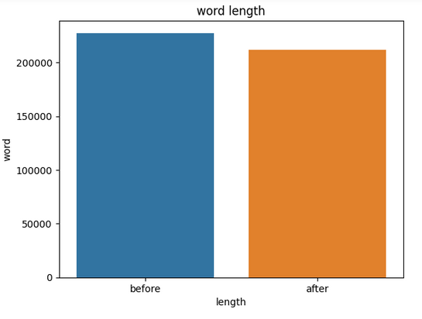
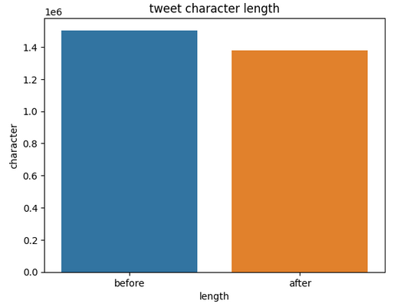
Results and Discussions(cont.)
From these bar plot, the amount of words and characters used from tweet dataset are also diminished when the function was used:
The amount of words removed was relatively low. There are still probability that the abusive word list did not cover all kinds of abusive words. And the function itself only remove certain words, but the sentence as a whole could not be sorted thoroughly.

Slide 9
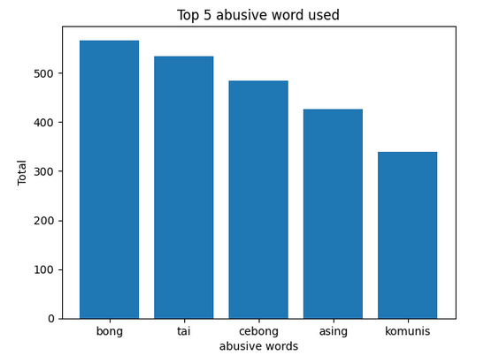
Results and Discussions(cont.)
From the tweets dataset, we can extract which abusive word that mostly used by the Indonesian (in the study). The results can be seen here:
From the graph, we can conclude that most of the abusive word used contain some political derogative for certain group, such as: ‘bong’,’asing’,’komunis’. This also inherent with the timing of the dataset was collected, which during the presidential election.

Slide 10
Conclusion:
Indonesian hate speech and abusive word are massive in tweets. But mostly it was intended to a personal user or certain group.
The dataset used has a high probability being collected during the Indonesian presidential election. It reflected on the abusive word used which is contain political derogative means
The restful API used to analyze the dataset, especially with the text cleaning function can be further added to analyze the whole sentence with sentiment analysis, rather than only by word.

Slide 11
THANK YOU!

